Slide 1
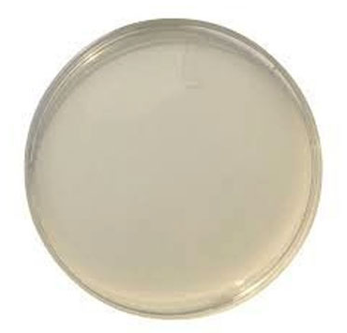
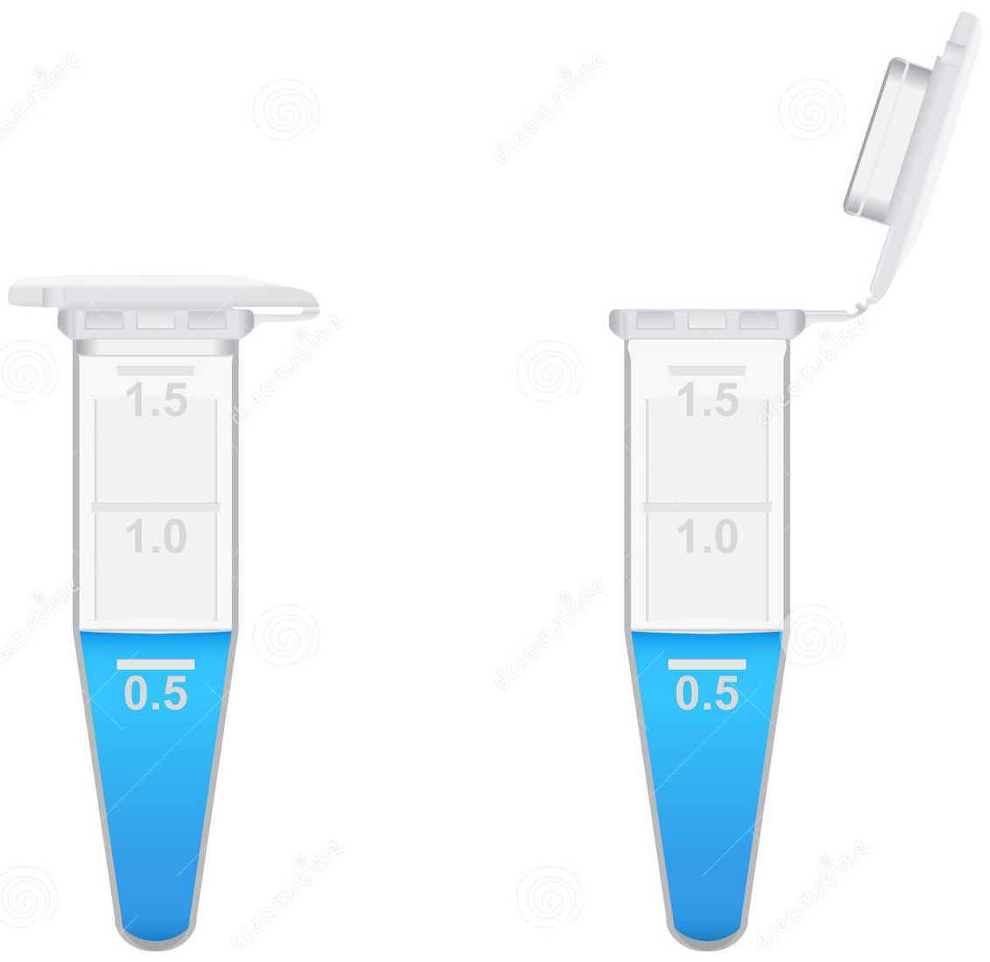
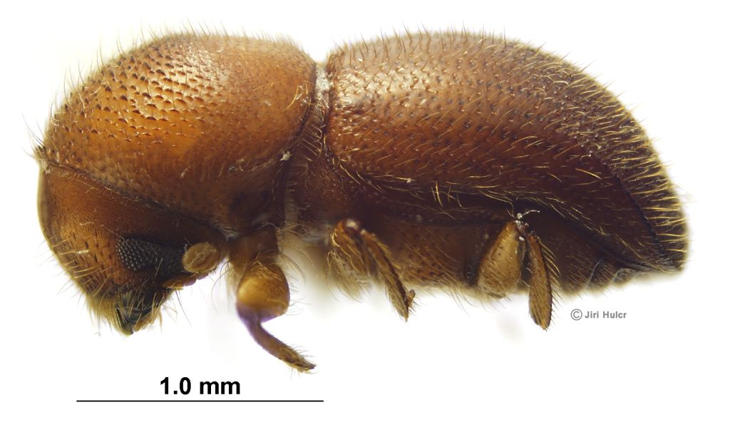
Isolating Fungi From Beetles
50 uL
0.1 Dilution
mycangium, head, fungi, etc.
50 uL
50 uL
0.01 Dilution
0.1
0.01
Primary Culture Plate Preparation
Prepare two tubes per each sample, label them “0.1” and “0.01”, fill each with 500 ul of water or PBS.
Suspend mycangium in the tube “0.1” and vortex.
Plate 50 ul of the suspension on media. This is your 0.1 dilution.
Transfer 50 ul of the initial suspension to the second tube (“0.01”) and vortex.
Plate 50 ul of the second suspension on second media plate. This is your 0.01 dilution.
Plate 5 ul of the second suspension on a third plate. This is your 0.001 dilution.
5 uL
0.001 Dilution

Slide 2
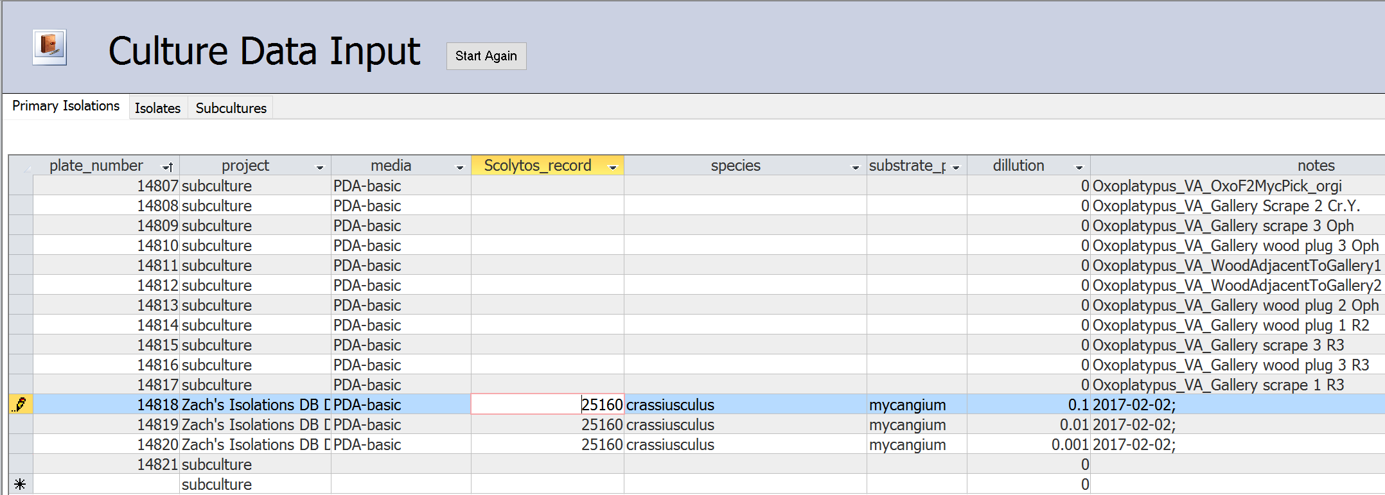
Entering Primary Cultures in Isolations DB
Plate #
14818
0.1 Dilution
Plate #
14819
0.01 Dilution
Label each of your primary culture plates with a new plate number, record under plate_number in Primary Cultures.
Assign a project to the plates, if your project is not available, add it to the projects table.
Record the media type on the plate, if not available, add to the media table.
When you isolate from a beetle, it should be given a scolytos_record, record the record number of the beetle the culture is from here. Record the species of beetle in the next column, add to OTUs table if needed.
Record where the fungi came from (beetle’s mycangia, head, wash, gallery, etc.) in the substrate_part column.
Record the dilution factor (0.1, 0.01, 0.001) of the culture plate in the dilution column.
In the notes, add any relevant notes, especially the date the plates were made. Use YYYY-MM-DD format.
Plate #
14820
0.001 Dilution

Slide 3
Morphotyping Primary Cultures and Counting CFUs
Plate #
14818
Plate #
14819
Plate #
14820
0.1 Dilution
0.01 Dilution
0.001 Dilution
red_square_blue_border
red_square_blue_border
red_square_blue_border
Morphotypes:
Morphotypes:
Morphotypes:
blue_circle
blue_circle
blue_circle
3
1
0
CFUs:
CFUs:
CFUs:
15
2
1
10
5
0
CFU Proportion:
CFU Proportion:
CFU Proportion:
75
10
5
Primary Culture Plate Morphotyping
After cultures have grown for a few days, describe colony types growing on plate. Be as descriptive as possible. These are morphotypes, they should be descriptive strings with underscores between words.
It is extremely important that your morphotypes are consistent across your project. If you see the same fungus multiple times on multiple plates, name it the same for all. You can reuse names from other projects, they will not be cross referenced.
Count number of colonies on each plate for each morphotype. This is a count of colony forming units or CFUs.
Estimate the percentage of the plate that is covered by each morphotype. Record this value as the CFU_proportion.

Slide 4
Recording Isolates in Isolations DB
Plate #
14818
Plate #
14819
Plate #
14820
0.1 Dilution
0.01 Dilution
0.001 Dilution
red_square_blue_border
red_square_blue_border
red_square_blue_border
Morphotypes:
Morphotypes:
Morphotypes:
blue_circle
blue_circle
blue_circle
3
1
0
CFUs:
CFUs:
CFUs:
15
2
1
10
5
0
CFU Proportion:
CFU Proportion:
CFU Proportion:
75
10
5
Isolates Database Entry
“Isolates” are morphotypes recorded from Primary Cultures (PC). As such, there will be duplicate entries for plates with >1 morph.
Plate_number is same as PC.
Isolate_name is “Plate#_morphotype”.
Record CFUs and CFU_proportion counted on previous page.
Record date counted in notes.
blue_circle red_square_blue_border
blue_circle
red_square_blue_border
blue_circle

Slide 5
Subculturing Isolates and Recording in DB
Subculturing Isolates and Entering in Database
To subculture an isolate, choose the lowest dilution Primary Culture plate you can find the morphotype on. This is your source_plate.
Take a small piece from the edge of the colony and culture it on a new plate. This is your subculture, give it a new plate_number.
Record the isolate_name of the colony from the previous page.
Record any relevant notes, including the date.
If this isolate will be archived, create a scolytos record for it and record the Scolytos_archive_vial on this form.
Culturing is now complete!* Now it’s time to get some DNA!
Plate #
14819 (Source)
Plate #
14821 (Subculture)
0.01 Dilution
14819_red_square_blue_border Subculture
Plate #
14820 (Source)
Plate #
14822 (Subculture)
0.001 Dilution
14820_blue_circle Subculture
Note about reviving fungi:
You may want to revive a fungus from the -80C. If you do, make a note that this is what you are doing and use the vial’s source plate as your subculture source_plate
*Results may vary

Slide 6
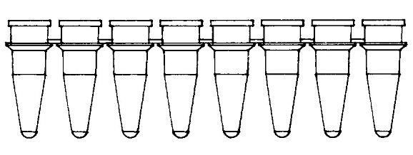
Extracting DNA from Fungi
Plate #
14822 (Subculture)
3% BSA
14822
14821
Tube set 1
Vortex thoroughly, spin down
14820_blue_circle Subculture
20uL supernatant
20uL
20uL Ex-n-amp:
14822
14821
14822
14821
Ext_ID
Run Ex-n-amp in thermocycler
Ext_ID
Tube set 1
Tube set 1
Tube set 2
Final Extractions
Scrape about 10uL of hyphae from the fungus using a sterile scalpel or pipette tip. Place in 20uL extraction solution in 8-strip PCR tubes. Label with subculture plate_numbers.
Place tubes in thermocycler and run Ex-n-amp protocol.
Add 20uL 3% BSA to each sample, vortex thoroughly. Spin down
Transfer 20uL of supernatant in new strip tube, this is the DNA, your extraction. You may now throw out the first set of tubes.
Instead of labelling these tubes with the source plate, label them with the final extraction_ID. Creating these entries is detailed on the next page.
Plate #
14821 (Subculture)
14819_red_square_blue_border Subculture

Slide 7
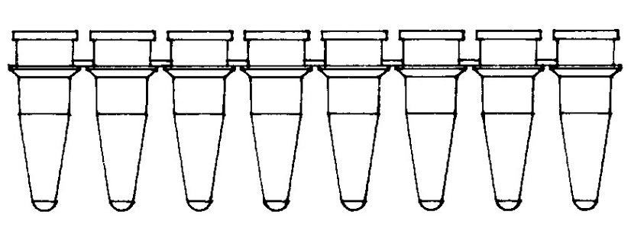
Recording extractions in the database
On the “Start Here” form in isolations, select “DNA from culture” for fungal DNA. If you are extracting from a beetle, you will choose “DNA from Scolytos sample.”
Create an extraction_id for each sample.
Record the subculture plate_number the sample came from. If you are extracting from a beetle, you will have a scolytos_record column in this position.
Record the isolate_name associated with the sample.
The date will automatically fill with today’s date. Change this if you run the extraction on a different date.
For most fungal extractions the method will be Ex-N-Amp-BSA, select an alternate if you did not use this method.
Record the project these samples are associated (should be the same from the Primary Cultures).
Record any relevant notes.
Record the original beetle species the fungi was isolated from under orig_species.
5733
5732
Tube set 2
Final Extractions

Slide 8
Creating PCR database entries
Creating PCR database entries
Create PCR_IDs for each of your samples and a positive and negative control.
Record the extraction_ID of each sample, including your positive control. Your negative control will have 0 as its extraction ID.
Record the isolate_name of each extraction you will be amplifying. Your positive control and negative control will have “pos.c.” and “neg.c.” as their isolate names respectively.
The date will autofill, change this if you have run or will run PCR on a different date.
Record the PCR protocol under method. This will depend on your primers and DNA.
Record the Taq you will be using, for most fungi this is “ExTaq_premix”.
Record your forward and reverse primer names under primer_F and primer_R respectively.
The remaining columns will be filled in after you run your PCR and gel.
Note: Many of these columns require you select a value from a drop down list. If your value is not on the list, add it to the appropriate table in the database. For instance, new PCR protocols should be recorded in the DNA_methods table. They will then be available to select in the method column.

Slide 9
Running PCR and gels
Running PCR
Create master mix, a common mix is listed below:
12.5 uL PremixTaq
9.5 uL PCR H20
1 uL Forward primer
1 uL Reverse primer
1 uL DMSO
Multiply these values by the number of reactions you will have (including controls) + 2. Mix the resulting volumes together in an Eppendorf tube and label Master Mix or MM.
Label 8-strip PCR tubes with your PCR_IDs from the database. Transfer 25 uL (sum of reagent volumes for one reaction) of the master mix to each vial to be used.
Transfer 1 uL of extraction to its corresponding PCR vial.
Run in thermocycler using protocol you recorded as the method.
Running Gels
Determine how many wells your gel will need, and select the best apparatus for your needs. You will need enough wells for all PCR samples plus one extra well per row for the ladder.
Either in new tubes, or on a piece of parafilm, mix 1.5 uL SYBR Green+6x Loading Dye mix with 5uL of your ladder, transfer to the left well, repeating for each row.
Mix 1.5uL SYBR Green+6x Loading Dye mix with 5 uL of PCR product, then transfer to a well in the gel. Keep track of what sample is in each well.
When mixing dye and PCR product, always use a new pippete tip and clean vial or parafilm for mixing.
When all PCR producted is loaded in gel, fill with 1x TAE buffer until gel is submerged, and close apparatus.
Set electrodes to ~110V and runtime as needed. 45 minutes seems to work well for most gels, and additional time can always be added.
Use Enduro to take a photograph of the gel under UV light.

Slide 10
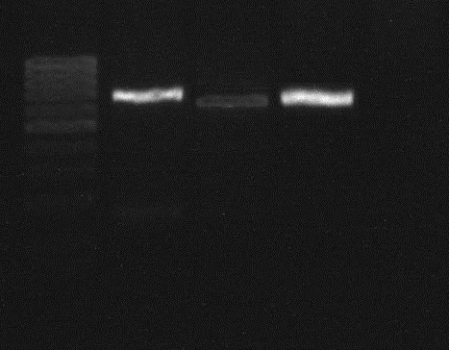
Recording gel results in the database
Ladder
Please remember to record your gel results in the database. Also, save an image of each gel you run in your lab records with a way to connect the bands to a PCR ID.
Check the box in PCR_ok if your gel returns a single band for a sample.
In band_strength, record how strong the band appears on the gel, if it appears at all.
10873
10874
10875
10876

Slide 11
Preparing a database entry for sequencing
Here, you will generate a database entry that connects your sequence to your PCR product and in turn, the rest of your work.
Decide if you will be sequencing one direction or both. If one, each PCR product submitted will have one sequence ID (seq_ID). If both, each will have two. Record the PCR_id in accordingly, the contig_ID will automatically.
Record the isolate_name the PCR product is associated with.
Record the primer the sequence reading will start at. If you will be sequencing both directions, one seq_ID will have the forward primer, the other will have the reverse.
The submitted_date will automatically select today as the date you submit your samples to be sequenced. Edit if needed.

Slide 12
Recording your sequence in the database
Once you have your sequences assembled, submit them to https://blast.ncbi.nlm.nih.gov to get an ID.
Record the PCR_ID of the sample the sequence came from, it will get a unique Seq_analysis_ID.
Record the assembled sequence itself, along with the gene the sequence was taken from.
Record the species of the first BLAST result as the BLAST_ID, including any specific modifiers of the strain or similar.
Record the Ident value in BLAST in the summary column, and the Query cover value in the Query coverage column.

